Slide 1


QUALIFICATION
of
Winning Team
GO GETTER

Slide 2



GO GETTER
Should be
1. Plan
Presenter

Slide 3
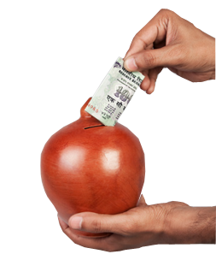
GO GETTER
Should be
2. 150 Personal PV
Monthly
Before 10th of every month

Slide 4

GO GETTER
Should have
3. 6 Working legs

Slide 5

GO GETTER
Should
4. Be a core

